Slide 1
W4111 – Introduction to Databases Section 003/V03, Fall 2022 Lecture 13: OLAP, Big Data
© Donald F. Ferguson, 2022

Slide 2

Contents

Slide 3
CAP, BASE

Slide 4
Core Transaction Concept is ACID Properties
http://slideplayer.com/slide/9307681
ACID
Atomic
“ALL OR NOTHING”
Transaction cannot be subdivided
Consistent
Transaction → transforms database from one consistent state to another consistent state
Isolated
Transactions execute independently of one another
Database changes not revealed to users until after transaction has completed
Durable
Database changes are permanent
The permanence of the database’s consistent state

Slide 5
CAP Theorem
Consistency
Every read receives the most recent write or an error.
Availability
Every request receives a (non-error) response – without guarantee that it contains the most recent write.
Partition Tolerance
The system continues to operate despite an arbitrary number of messages being dropped (or delayed) by the network between nodes

Slide 6
Consistency Models
STRONG CONSISTENCY: Strong consistency is a consistency model where all subsequent accesses to a distributed system will always return the updated value after the update.
WEAK CONSISTENCY: It is a consistency model used in distributed computing where subsequent accesses might not always be returning the updated value. There might be inconsistent responses.
EVENTUAL CONSISTENCY: Eventual consistency is a special type of weak consistency method which informally guarantees that, if no new updates are made to a given data item, eventually all accesses to that item will return the last updated value.

Slide 7
BASE
Eventually-consistent services are often classified as providing BASE (Basically Available, Soft state, Eventual consistency) semantics, in contrast to traditional ACID (Atomicity, Consistency, Isolation, Durability) guarantees. Rough definitions of each term in BASE:
Basically Available: basic reading and writing operations are available as much as possible (using all nodes of a database cluster), but without any kind of consistency guarantees (the write may not persist after conflicts are reconciled, the read may not get the latest write)
Soft state: without consistency guarantees, after some amount of time, we only have some probability of knowing the state, since it may not yet have converged
Eventually consistent: If the system is functioning and we wait long enough after any given set of inputs, we will eventually be able to know what the state of the database is, and so any further reads will be consistent with our expectations

Slide 8
Eventual Consistency
Availability and scalability via
Multiple, replicated data stores.
Read goes to “any” replica.
PUT/POST/DELETE
Goes to any replica
Change propagate asynchronously
GET may not see the latest value if the update has not propagated to the replica.
There are several algorithms for conflict resolution
Detect and handle in application.
Clock/change vectors/version numbers
… …
get
put

Slide 9
ACID – BASE (Simplistic Comparison)
(Or other strategy)

Slide 10
Scalability

Slide 11
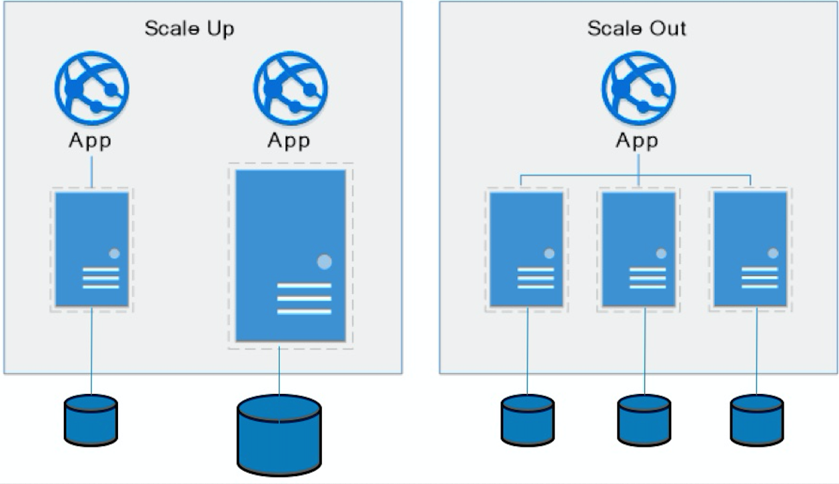
Approaches to Scalability
Scalability is the property of a system to handle a growing amount of work by adding resources to the system.
Replace system with a bigger machine, e.g. more memory, CPU, ... ...
Scale-up:
Less incremental.
More disruptive.
More expensive for extremely large systems.
Does not improve availability
Scale-out:
Incremental cost.
Data replication enables availability.
Does not work well for functions like JOIN, referential integrity, ... ...
Add another system.

Slide 12
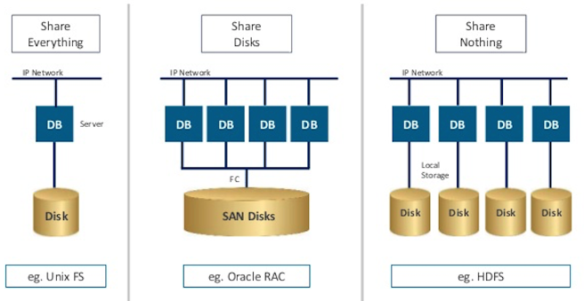
Disk Architecture for Scale-Out
Share disks:
Is basically scale-up for data/disks. You can use NAS, SAN and RAID.
Isolation/Integrity requires distributed locking to control access from multiple database servers.
Share nothing:
Is basically scale-out for disks.
Data is partitioned into shards based on a function f() applied to a key.
Can improve availability, at the code consistency, with data replication.
There is a router that sends requests to the proper shard based on the function.

Slide 13
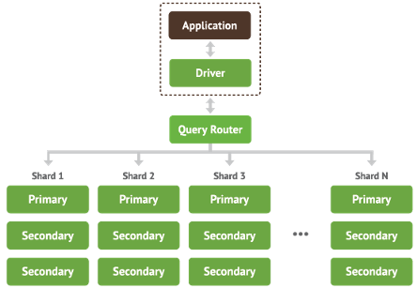
Shared Nothing, Scale-Out
MongoDB Sharding
DynamoDB Partitioning

Slide 14
Data Models, REST, HATEOS
14 | Introduction to Databases (F22): Lecture 13 – OLAP, Big Data © Donald F. Ferguson, 2022

Slide 15
Data Modeling Concepts and the Web
Almost any data model has the same core concepts:
Types and instances:
Entity Type: A definition of a type of thing with properties and relationships.
Entity Instance: A specific instantiation of the Entity Type
Entity Set Instance: An Entity Type that:
Has properties and relationships like any entity, but ...
Has at least one special relationship – contains.
Operations, minimally CRUD, that manipulate entity types and instances:
Create (POST)
Retrieve (GET)
Update (PUT)
Delete (DELETE)
Reference/Identity/... ... (URL)

Slide 16
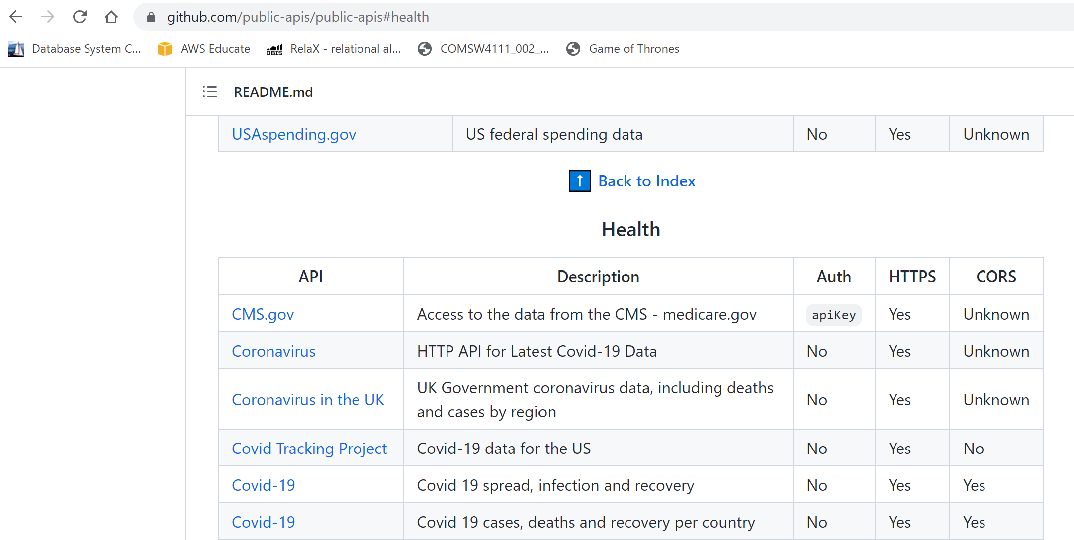
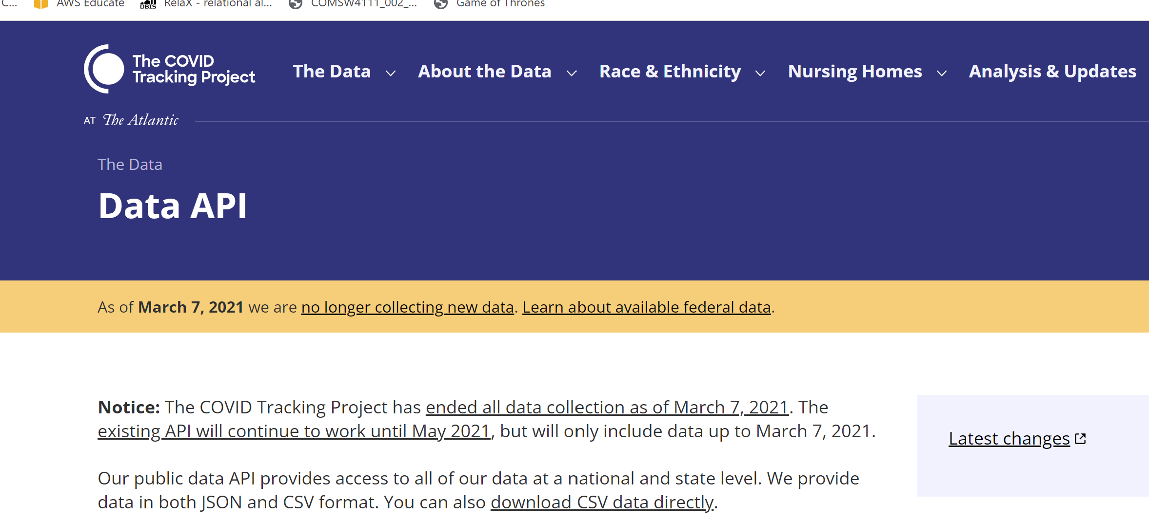
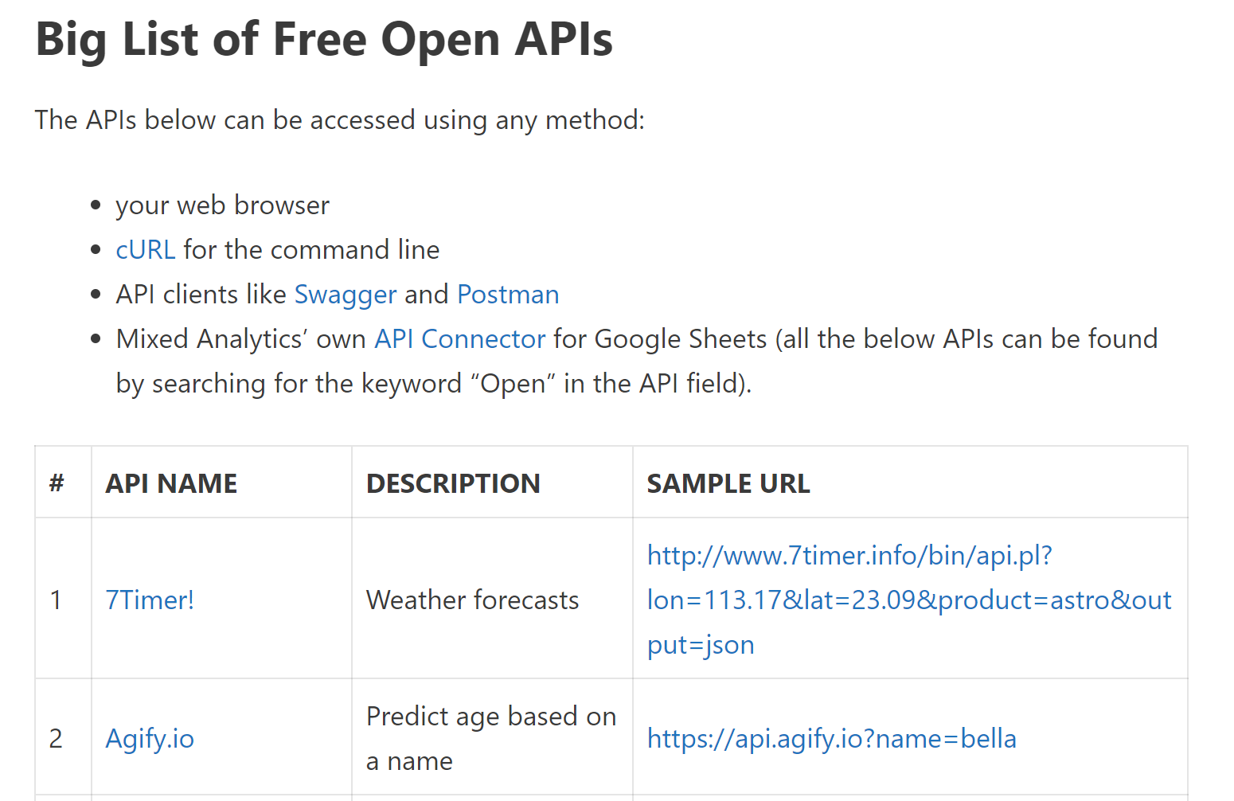
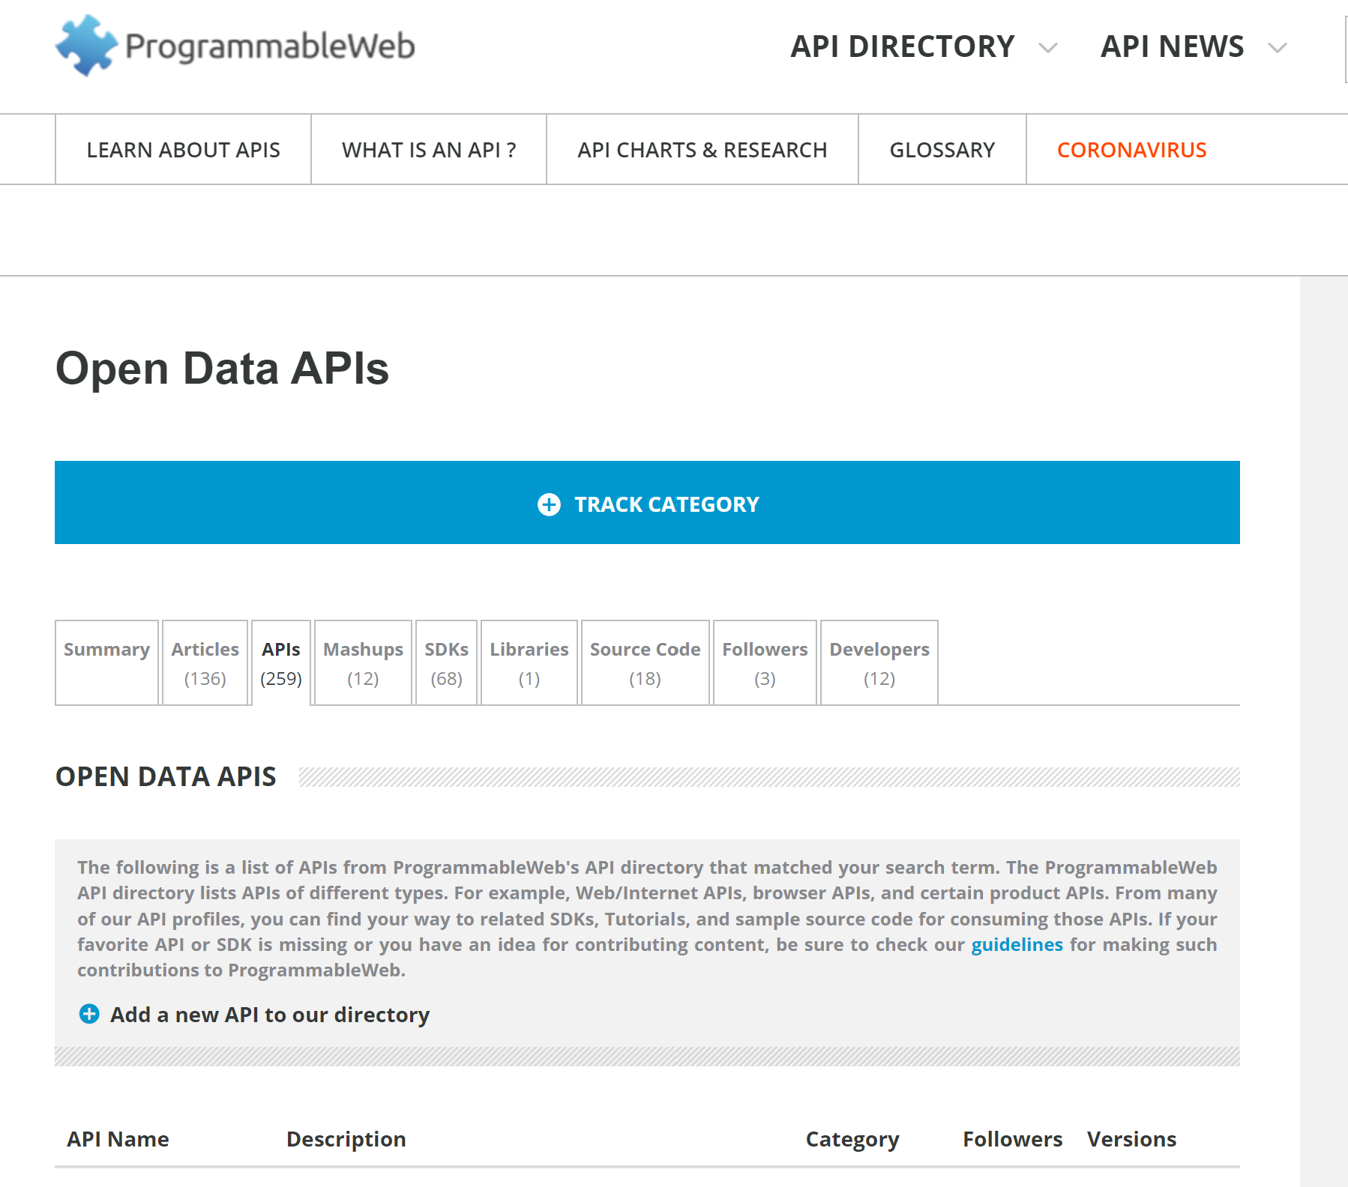
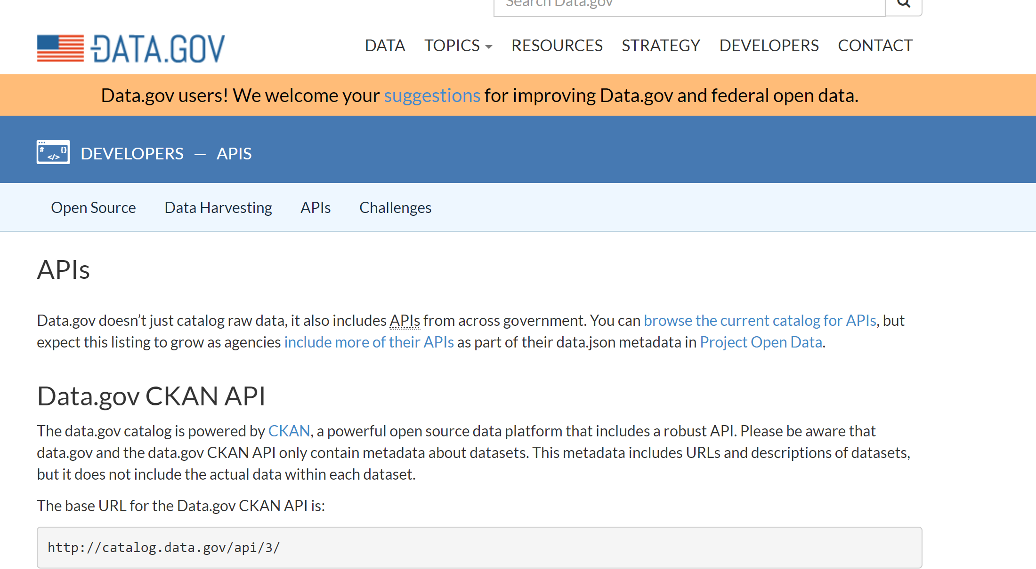
Data Web

Slide 17
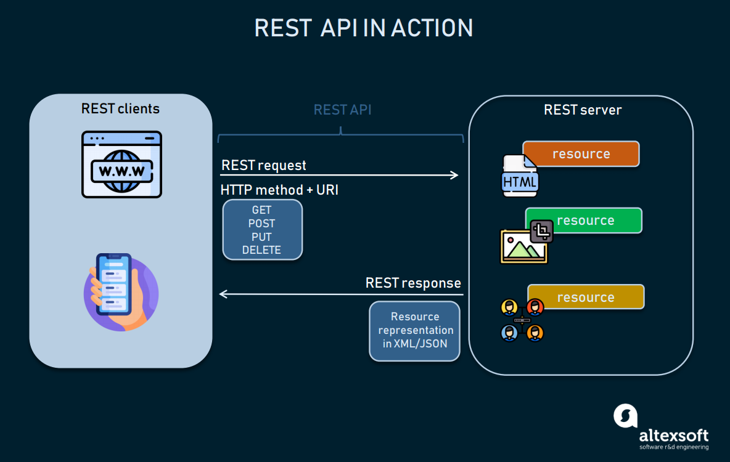
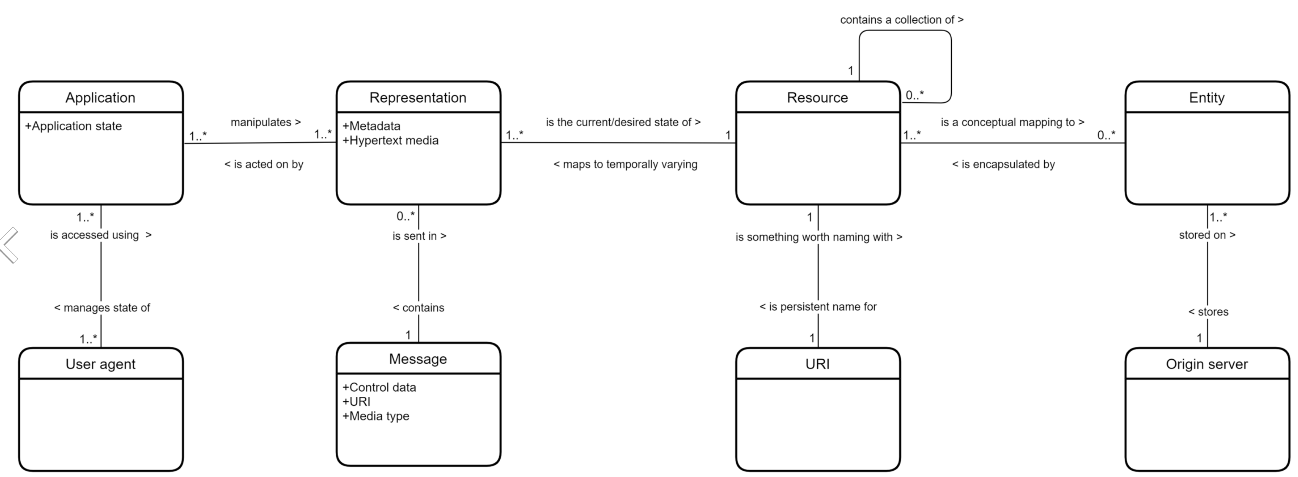
REST
“Representational state transfer (REST) is a software architectural style that was created to guide the design and development of the architecture for the World Wide Web. REST defines a set of constraints for how the architecture of an Internet-scale distributed hypermedia system, such as the Web, should behave. … …
REST has been employed throughout the software industry and is a widely accepted set of guidelines for creating stateless, reliable web APIs. A web API that obeys the REST constraints is informally described as RESTful. RESTful web APIs are typically loosely based on HTTP methods to access resources via URL-encoded parameters and the use of JSON or XML to transmit data.”

Slide 18
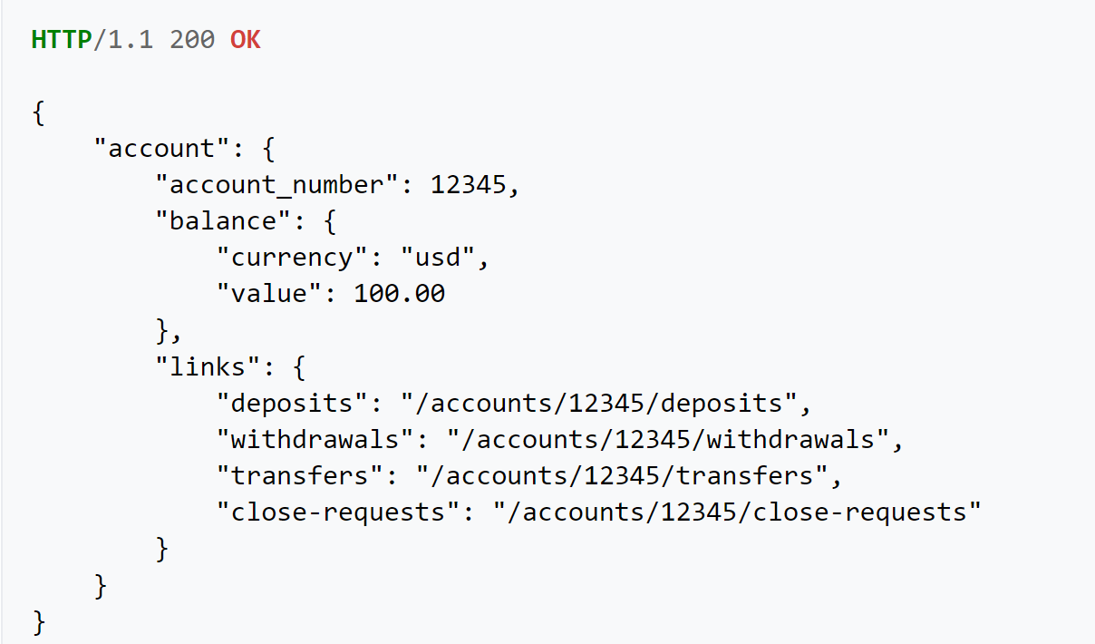
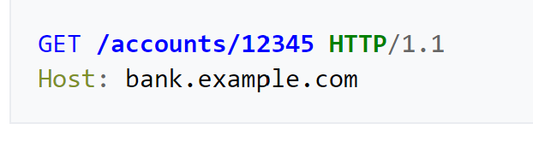
HATEOAS
“Hypermedia as the Engine of Application State (HATEOAS) is a constraint of the REST application architecture that distinguishes it from other network application architectures.
With HATEOAS, a client interacts with a network application whose application servers provide information dynamically through hypermedia. A REST client needs little to no prior knowledge about how to interact with an application or server beyond a generic understanding of hypermedia.
The restrictions imposed by HATEOAS decouple client and server. This enables server functionality to evolve independently.”
Request
Response

Slide 19
REST and Resources
URL = Universal Resource Locator
(URL, content-type) application/JSON, text/html, image/jpg

Slide 20
URLs

Slide 21
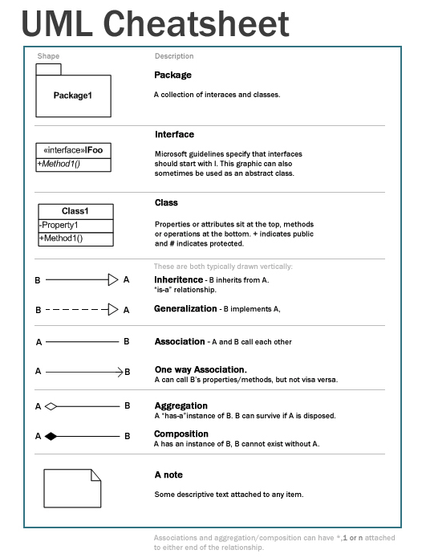
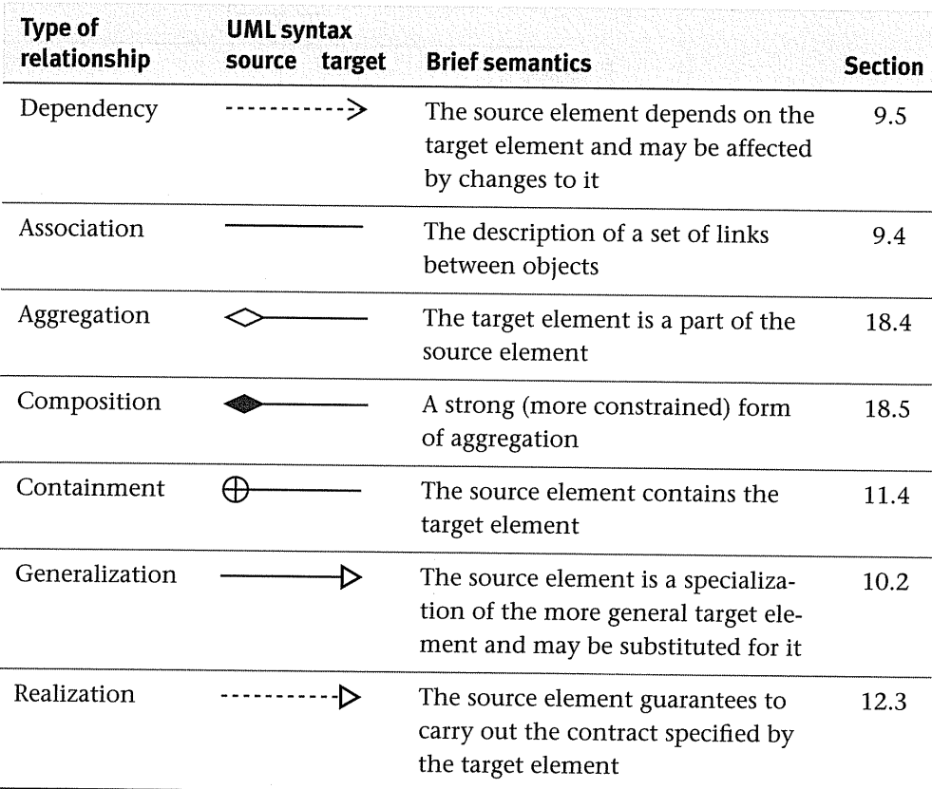
UML
https://softwareengineering.stackexchange.com/questions/405247/what-is-the-difference-between-containment-and-aggregation-relationship-in-uml
https://khalilstemmler.com/files/resources/umlcheatsheet.jpg

Slide 22
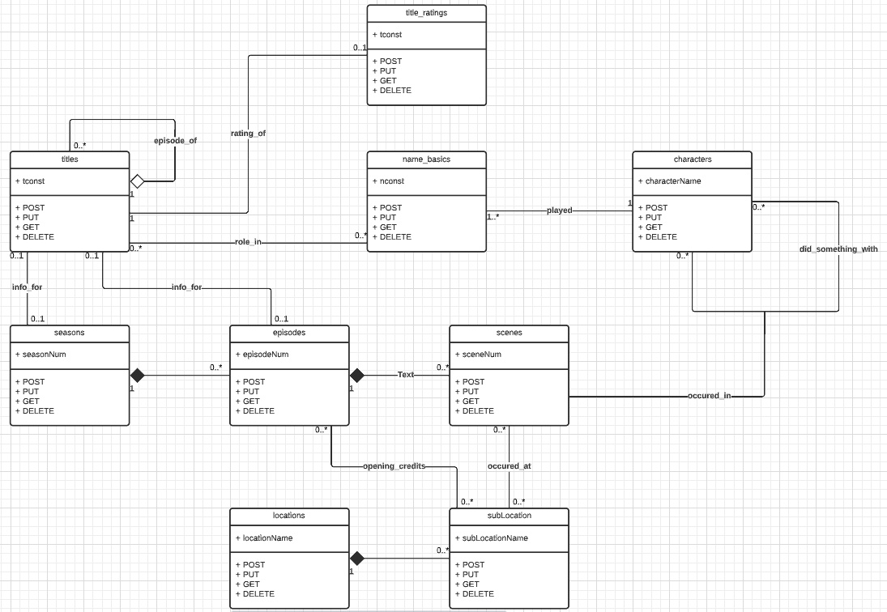
First Pass at a Resource Model using UML
Did not include all attributes.
May not be accurate
Did before coffee (really bad idea).
Made early this morning.
This is fun for about 10 minutes and then is boring.
Like all modeling
You can go crazy doing it.
Just enough is the ideal.
Original here.

Slide 23
This Would Lead to Resource Paths Link ... ...
/seasons
/seasons/{seasonNum}
/seasons/{seasonNum}/episodes
/seasons/{seasonNum}/episodes/{episodeNum}/scenes
/characters
/characters/{characterName}/scenes
/characters/{characterName}/{relationshipName}
/characters/{characterName}/actors
/characters/{characterName}/actors/{nconst}/knownFor
... ...
Partial, initial mapping

Slide 24
Walk Through Some Code

Slide 25
Decision Support

Slide 26

Concepts
Schema Design Tradeoffs Data Warehouse, Data Lake, ETL

Slide 27
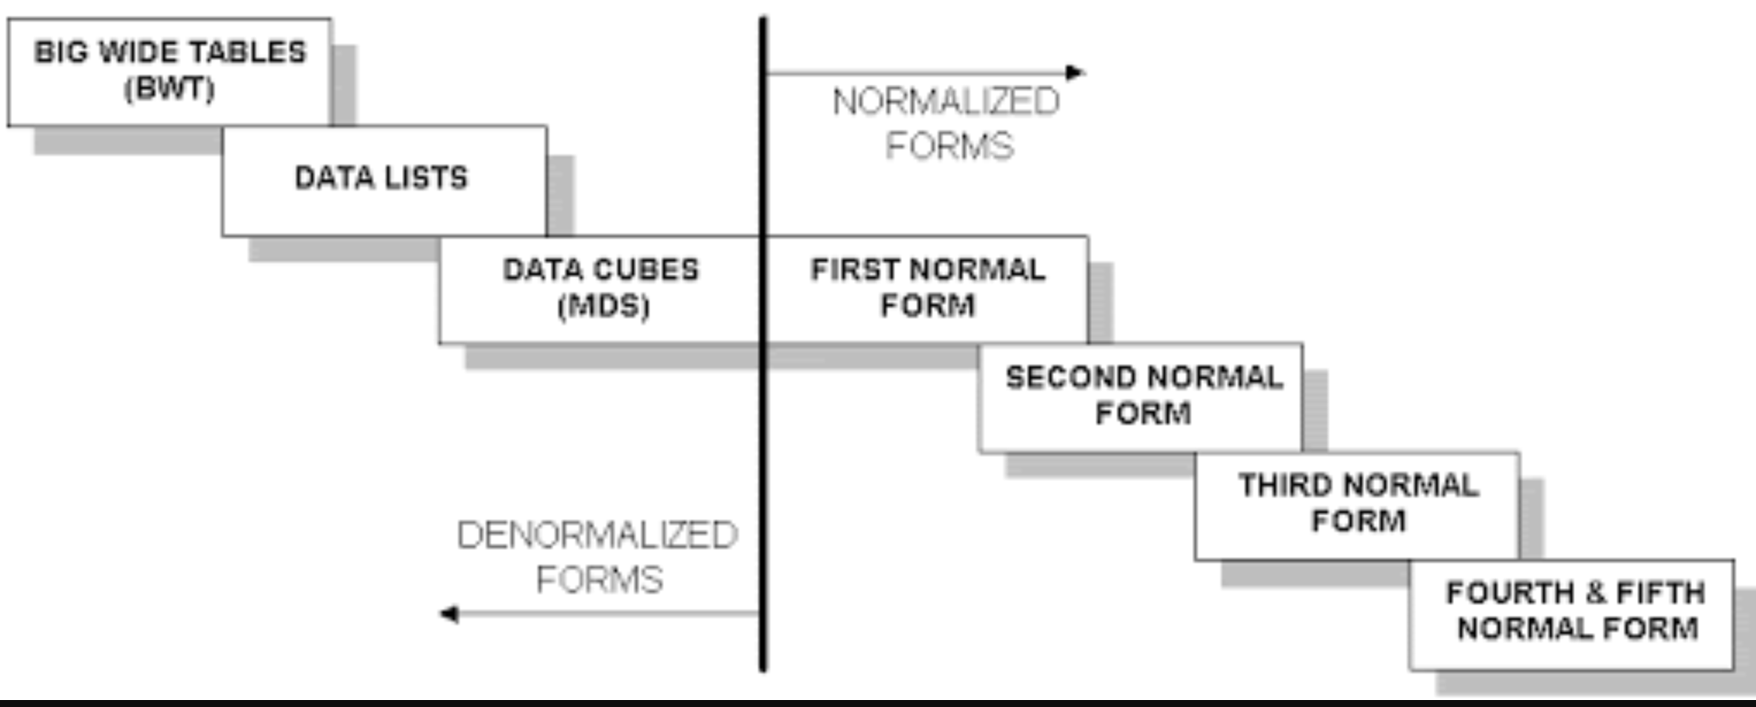
Wide Flat Tables
Good for Integrity
Good for Query
Improve query performance by precomputing and saving:
JOINs
Aggregation
Derived/computed columns
One of the primary strength of the relational model is maintaining “integrity” when applications create, update and delete data. This relies on:
The core capabilities of the relational model, e.g. constraints.
A well-design database (We will cover a formal definition – “normalization” in more detail later.
Data models that are well designed for integrity are very bad for read only analysis queries. We will build and analyze wide flat tables as part of the analysis tasks in HW3, HW4 as projects.

Slide 28
Decision Support Systems
Decision-support systems are used to make business decisions, often based on data collected by on-line transaction-processing systems.
Examples of business decisions:
What items to stock?
What insurance premium to change?
To whom to send advertisements?
Examples of data used for making decisions
Retail sales transaction details
Customer profiles (income, age, gender, etc.)

Slide 29
Decision-Support Systems: Overview
Data analysis tasks are simplified by specialized tools and SQL extensions
Example tasks
For each product category and each region, what were the total sales in the last quarter and how do they compare with the same quarter last year
As above, for each product category and each customer category
Statistical analysis packages (e.g., : S++) can be interfaced with databases
Statistical analysis is a large field, but not covered here
Data mining seeks to discover knowledge automatically in the form of statistical rules and patterns from large databases.
A data warehouse archives information gathered from multiple sources, and stores it under a unified schema, at a single site.
Important for large businesses that generate data from multiple divisions, possibly at multiple sites
Data may also be purchased externally

Slide 30
Data Warehousing
Data sources often store only current data, not historical data
Corporate decision making requires a unified view of all organizational data, including historical data
A data warehouse is a repository (archive) of information gathered from multiple sources, stored under a unified schema, at a single site
Greatly simplifies querying, permits study of historical trends
Shifts decision support query load away from transaction processing systems

Slide 31
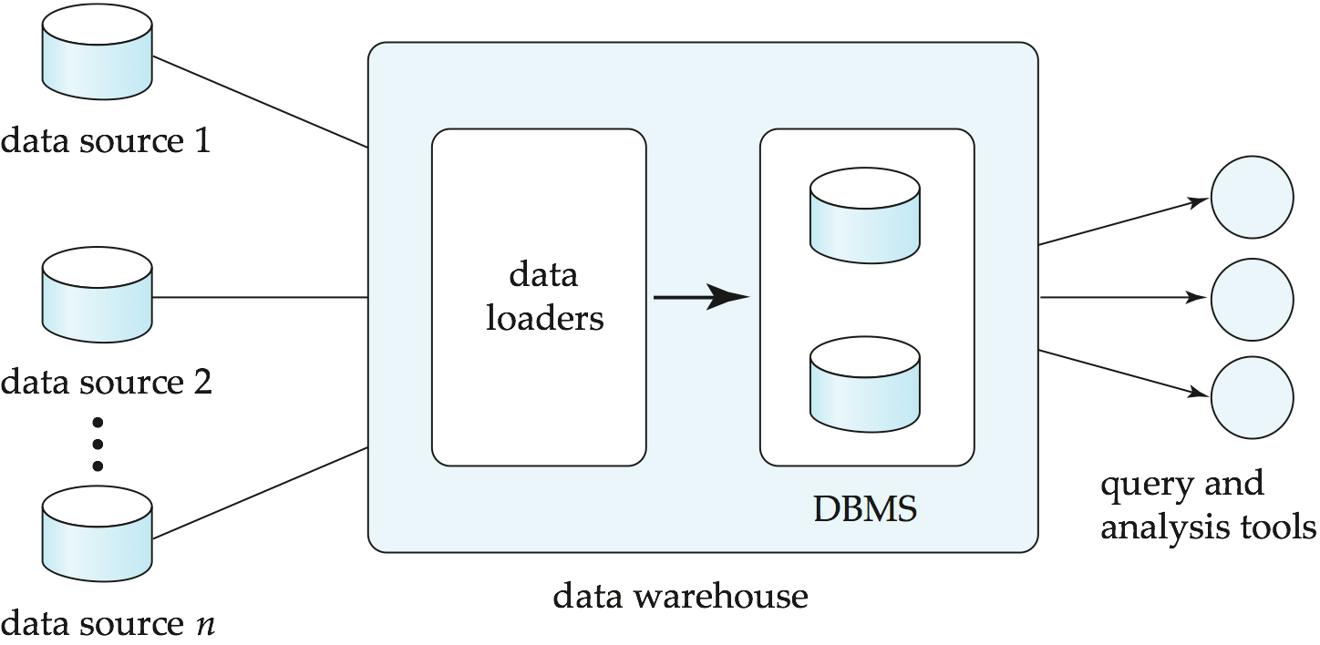
Data Warehousing

Slide 32
Data Warehouse vs Data Lake
https://www.grazitti.com/blog/data-lake-vs-data-warehouse-which-one-should-you-go-for/

Slide 33
Simplistic: Data Warehouse vs Data Lake
https://panoply.io/data-warehouse-guide/data-warehouse-vs-data-lake/

Slide 34
Design Issues
When and how to gather data
Source driven architecture: data sources transmit new information to warehouse, either continuously or periodically (e.g., at night)
Destination driven architecture: warehouse periodically requests new information from data sources
Keeping warehouse exactly synchronized with data sources (e.g., using two-phase commit) is too expensive
Usually OK to have slightly out-of-date data at warehouse
Data/updates are periodically downloaded form online transaction processing (OLTP) systems.
What schema to use
Schema integration

Slide 35
More Warehouse Design Issues
Data cleansing
E.g., correct mistakes in addresses (misspellings, zip code errors)
Merge address lists from different sources and purge duplicates
How to propagate updates
Warehouse schema may be a (materialized) view of schema from data sources
What data to summarize
Raw data may be too large to store on-line
Aggregate values (totals/subtotals) often suffice
Queries on raw data can often be transformed by query optimizer to use aggregate values

Slide 36
Warehouse Schemas
Dimension values are usually encoded using small integers and mapped to full values via dimension tables
Resultant schema is called a star schema
More complicated schema structures
Snowflake schema: multiple levels of dimension tables
Constellation: multiple fact tables

Slide 37
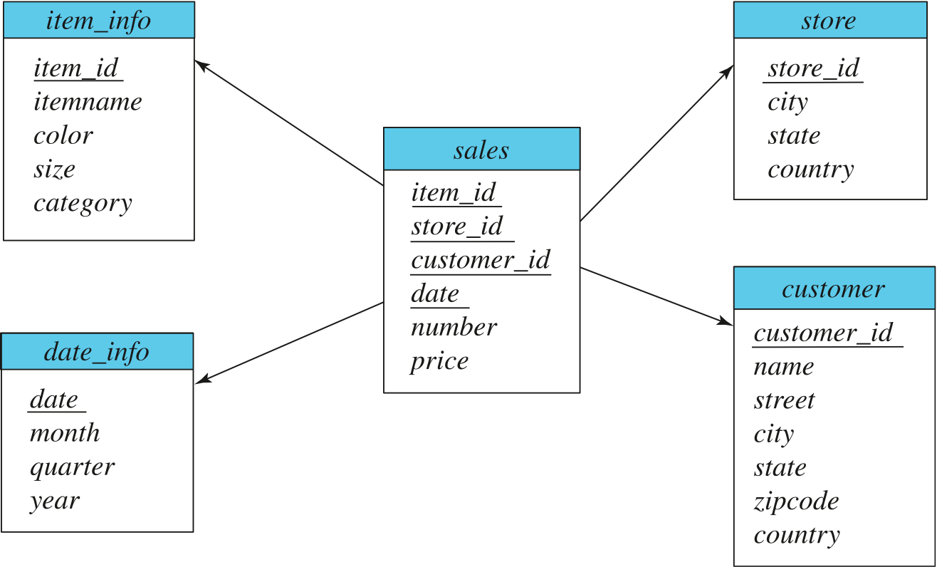
Data Warehouse Schema

Slide 38
Overview (Cont.)
Common steps in data analytics
Gather data from multiple sources into one location
Data warehouses also integrated data into common schema
Data often needs to be extracted from source formats, transformed to common schema, and loaded into the data warehouse
Can be done as ETL (extract-transform-load), or ELT (extract-load-transform)
Generate aggregates and reports summarizing data
Dashboards showing graphical charts/reports
Online analytical processing (OLAP) systems allow interactive querying
Statistical analysis using tools such as R/SAS/SPSS
Including extensions for parallel processing of big data
Build predictive models and use the models for decision making

Slide 39
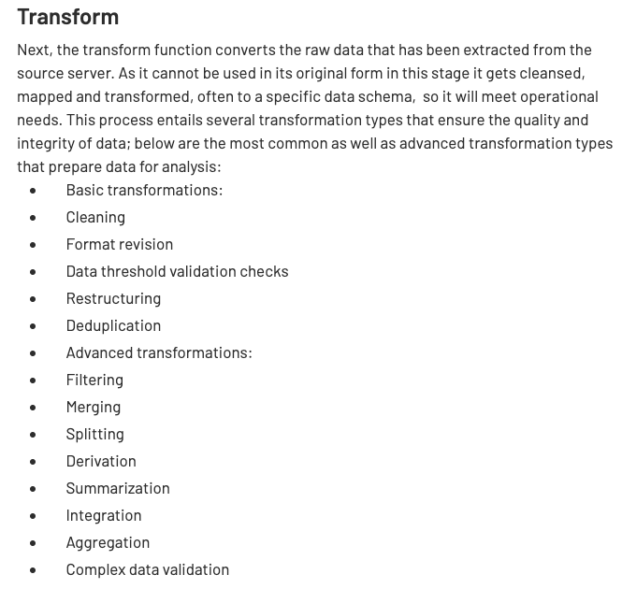
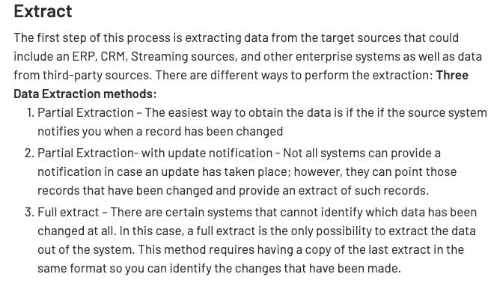
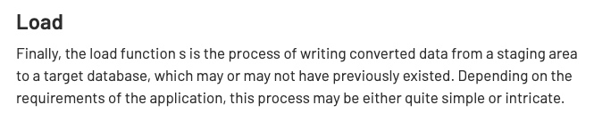
ETL Concepts
https://databricks.com/glossary/extract-transform-load

Slide 40
MapReduce, Spark (and ETL)
40 | Introduction to Databases (F22): Lecture 13 – OLAP, Big Data

Slide 41
MapReduce
MapReduce is a data flow program with relatively simple operators on the data set.
op1
op2
op3
With each operator implemented in parallel on multiple nodes for performance.
What if we want more complex “operators?”

Slide 42
Algebraic Operations
Current generation execution engines
natively support algebraic operations such as joins, aggregation, etc. natively.
Allow users to create their own algebraic operators
Support trees of algebraic operators that can be executed on multiple nodes in parallel
E.g. Apache Tez, Spark
Tex provides low level API; Hive on Tez compiles SQL to Tez
Spark provides more user-friendly API
In the relational model,
The are relations.
A fixed set of operators that produce relations from relations (closed).
Are declarative languages and compute the execution graph/plan.
The Spark/... ... engines:
Enable programmers to develop and add new operators.
Operators convert reliable distributed datasets/data frames to new RDDs/data frames.
Data engineer explicitly defines the execution graph (data flow).

Slide 43
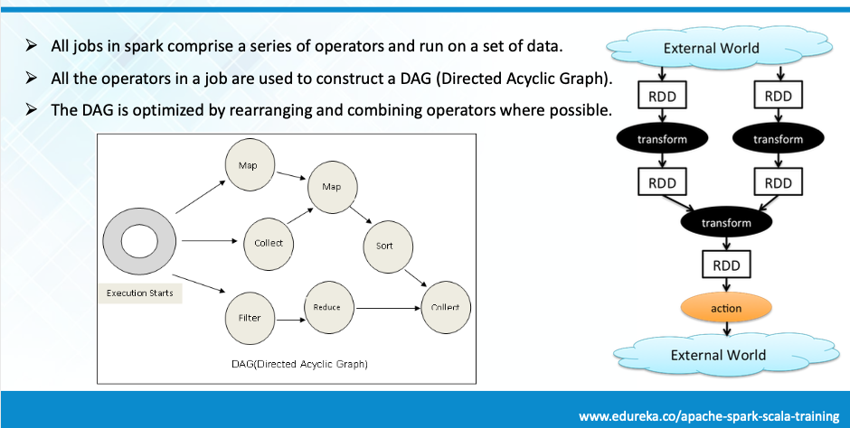
Spark

Slide 44
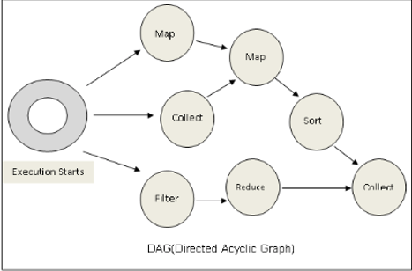
Spark vs SQL
Conceptually similar to query evaluation graph, but ...
You explicitly define the graph.
You can develop your own operators.
You can define levels of parallelism that the infrastructure manages.
SQL is declarative, and the query engine transparently produces the execution plan.

Slide 45
Algebraic Operations in Spark
Resilient Distributed Dataset (RDD) abstraction
Collection of records that can be stored across multiple machines
RDDs can be created by applying algebraic operations on other RDDs
RDDs can be lazily computed when needed
Spark programs can be written in Java/Scala/R
Our examples are in Java
Spark makes use of Java 8 Lambda expressions; the code
s - > Arrays.asList(s.split(" ")).iterator()
defines unnamed function that takes argument s and executes the expression Arrays.asList(s.split(" ")).iterator() on the argument
Lambda functions are particularly convenient as arguments to map, reduce and other functions

Slide 46
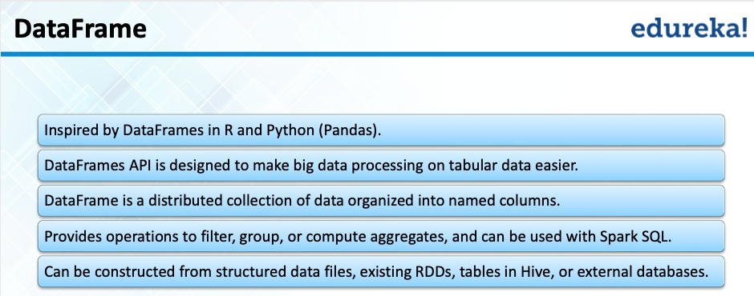
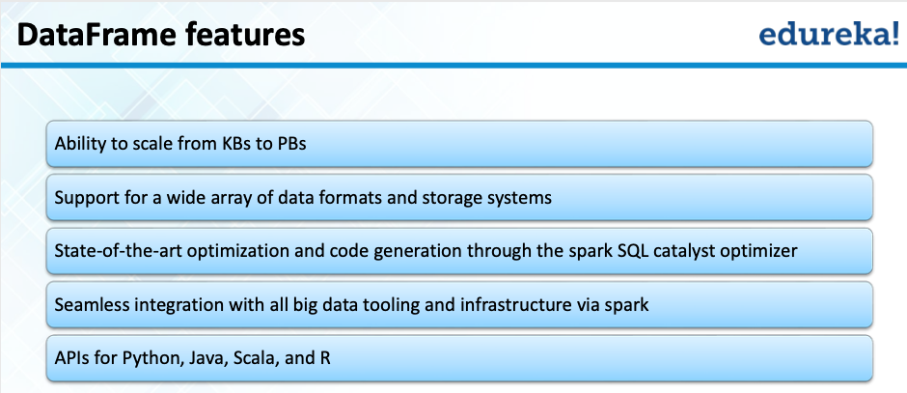
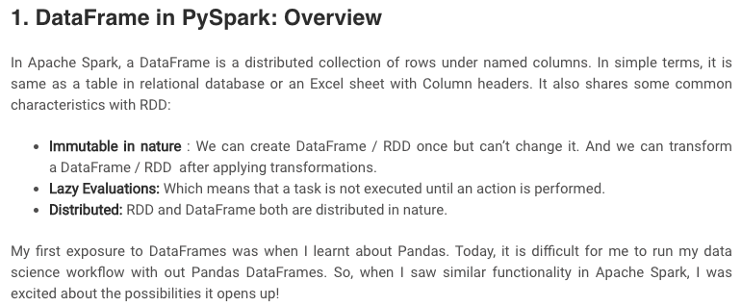
Spark/PySpark
https://www.analyticsvidhya.com/blog/2016/10/spark-dataframe-and-operations/

Slide 47
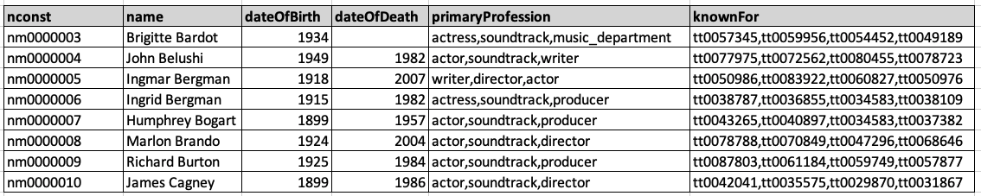
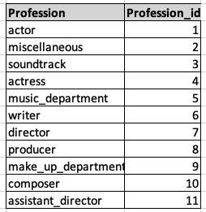
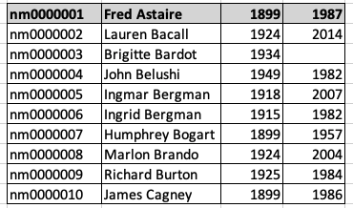
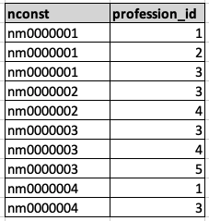
Conceptual Example
Remember that really unpleasant set of queries and stored procedure we had to write for the midterm? You had to convert from ... ...
To

Slide 48
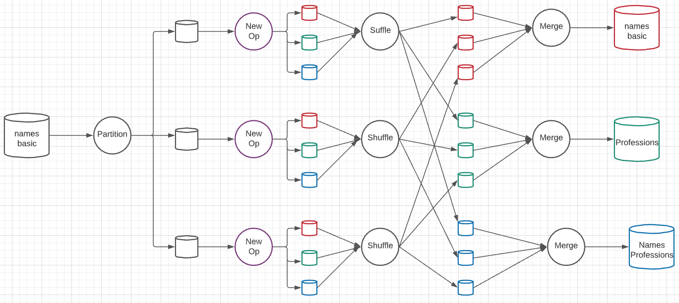
A New Algebraic Operator
Parallelism level is 3 simultaneous services at each stage.
Input is a dataset and column ID
Output is three datasets: dataset with column removed, table of distinct column values, associative entity.

Slide 49
OLAP
49 | Introduction to Databases (F22): Lecture 13 – Big Data and Analytics

Slide 50
Data Analysis and OLAP
Online Analytical Processing (OLAP)
Interactive analysis of data, allowing data to be summarized and viewed in different ways in an online fashion (with negligible delay)
We use the following relation to illustrate OLAP concepts
sales (item_name, color, clothes_size, quantity)
This is a simplified version of the sales fact table joined with the dimension tables, and many attributes removed (and some renamed)

Slide 51
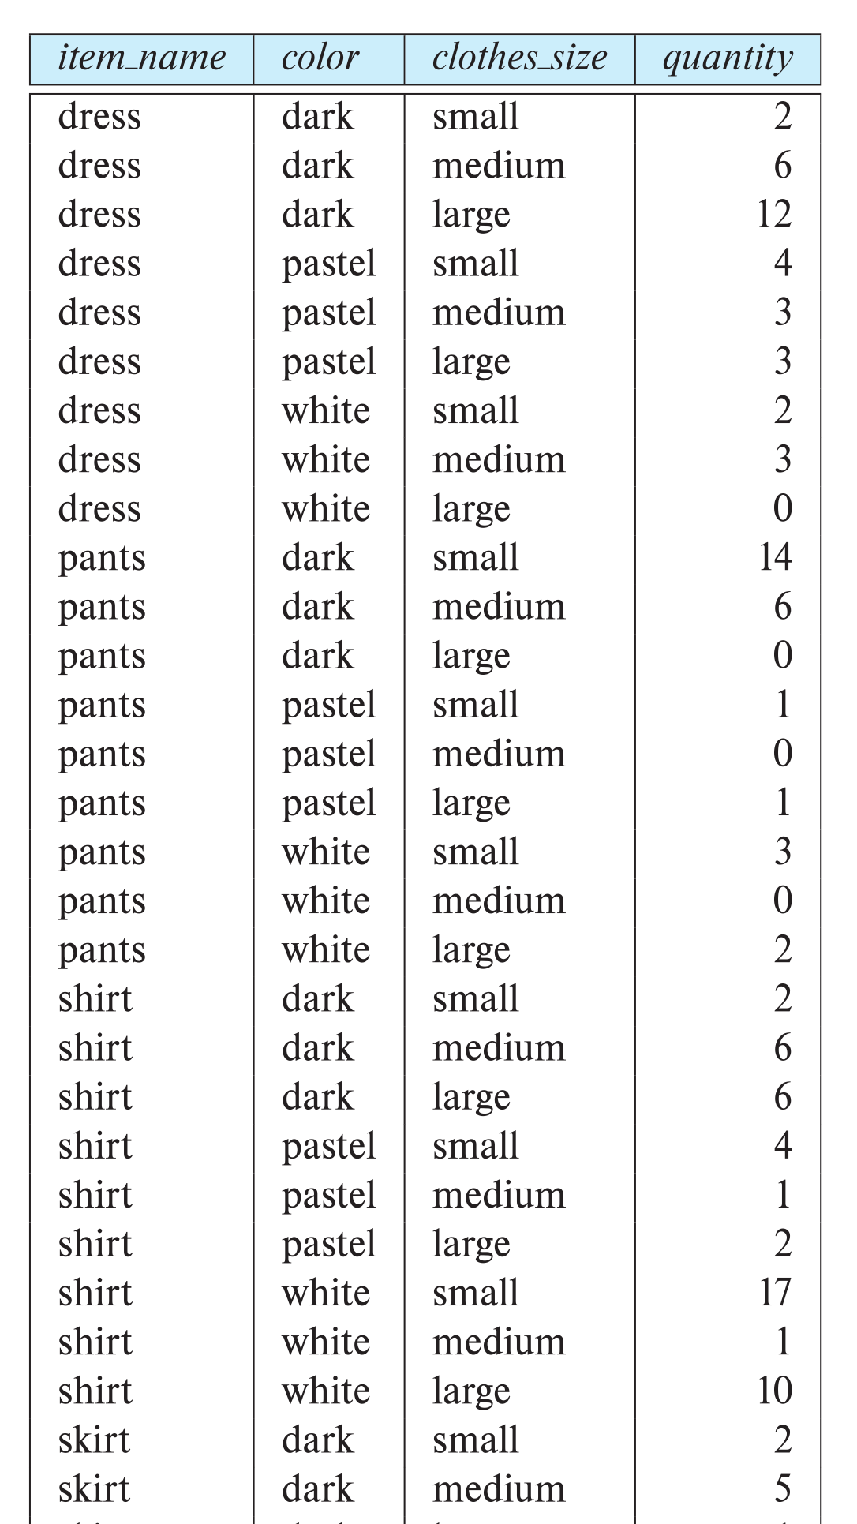
Example sales relation
...
...
...
...
...
...
...
...

Slide 52
Cross Tabulation of sales by item_name and color
The table above is an example of a cross-tabulation (cross-tab), also referred to as a pivot-table.
Values for one of the dimension attributes form the row headers
Values for another dimension attribute form the column headers
Other dimension attributes are listed on top
Values in individual cells are (aggregates of) the values of the dimension attributes that specify the cell.

Slide 53
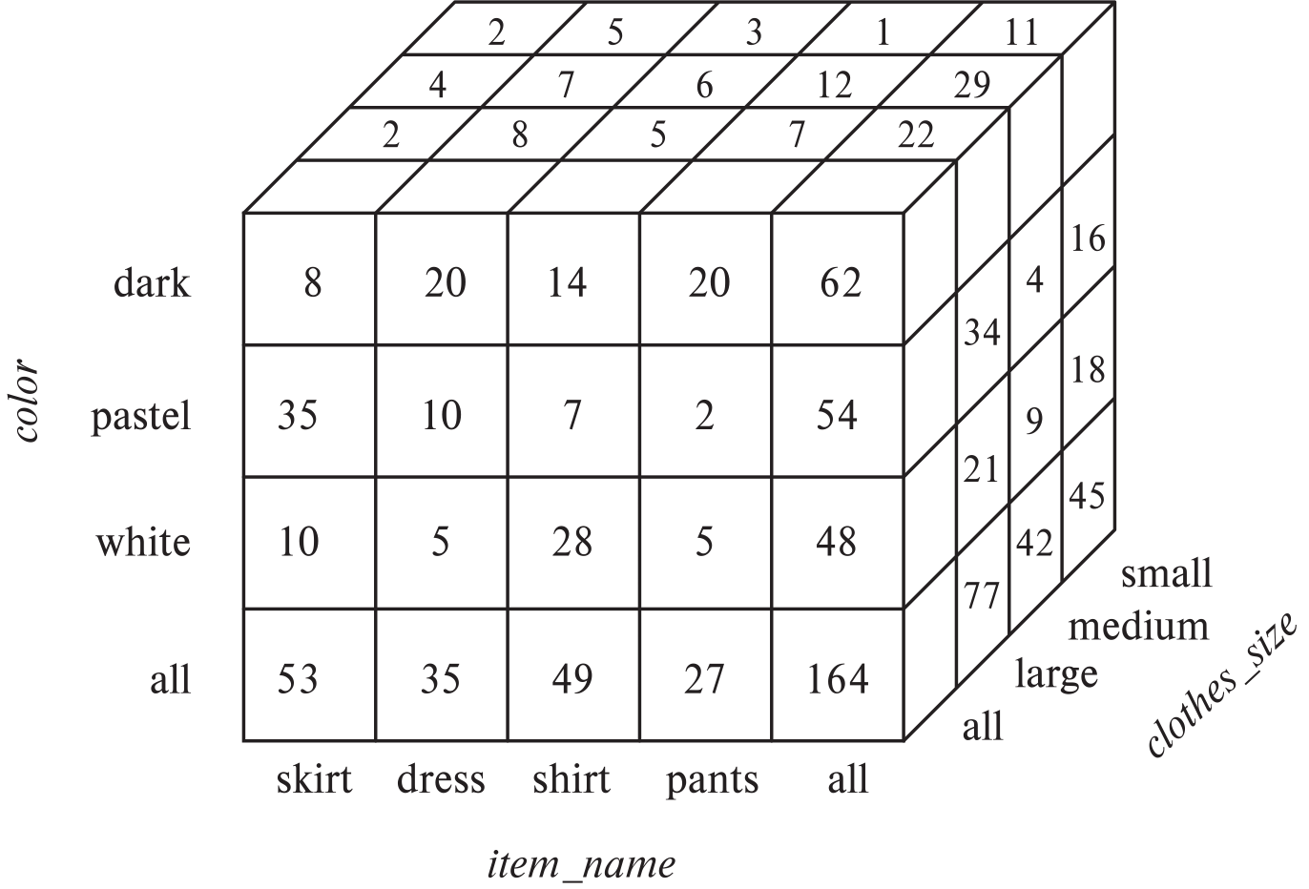
Data Cube
A data cube is a multidimensional generalization of a cross-tab
Can have n dimensions; we show 3 below
Cross-tabs can be used as views on a data cube

Slide 54
Online Analytical Processing Operations
Pivoting: changing the dimensions used in a cross-tab
E.g., moving colors to column names
Slicing: creating a cross-tab for fixed values only
E.g., fixing color to white and size to small
Sometimes called dicing, particularly when values for multiple dimensions are fixed.
Rollup: moving from finer-granularity data to a coarser granularity
E.g., aggregating away an attribute
E.g., moving from aggregates by day to aggregates by month or year
Drill down: The opposite operation - that of moving from coarser-granularity data to finer-granularity data

Slide 55
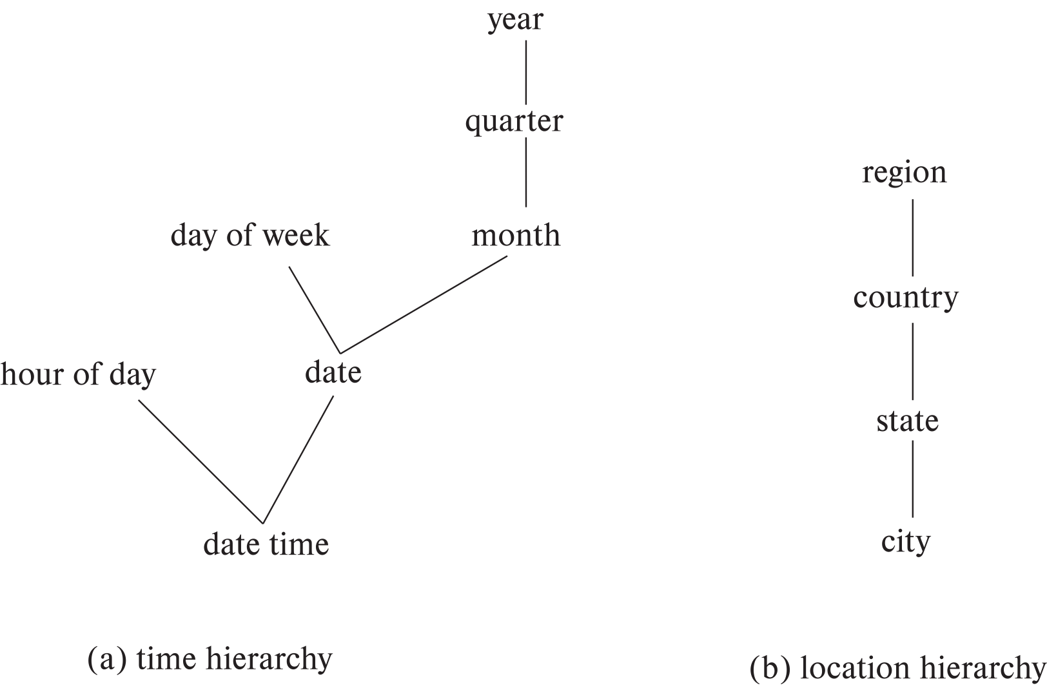
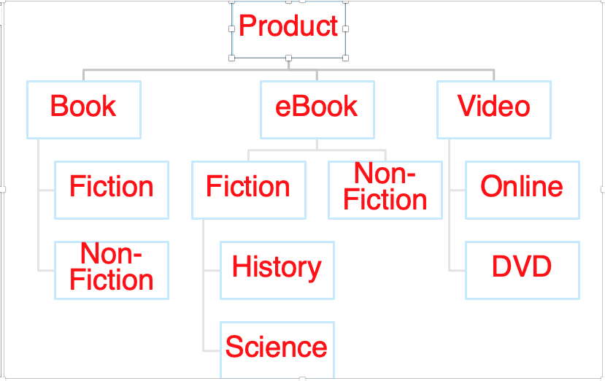
Hierarchies on Dimensions
Hierarchy on dimension attributes: lets dimensions be viewed at different levels of detail
E.g., the dimension datetime can be used to aggregate by hour of day, date, day of week, month, quarter or year
Another dimension could be ... Product category.

Slide 56
Another Dimension Example – Product Categories
Product
Book
eBook
Video
Fiction
Non-Fiction
Non-
Fiction
Fiction
Online
DVD
History
Science

Slide 57
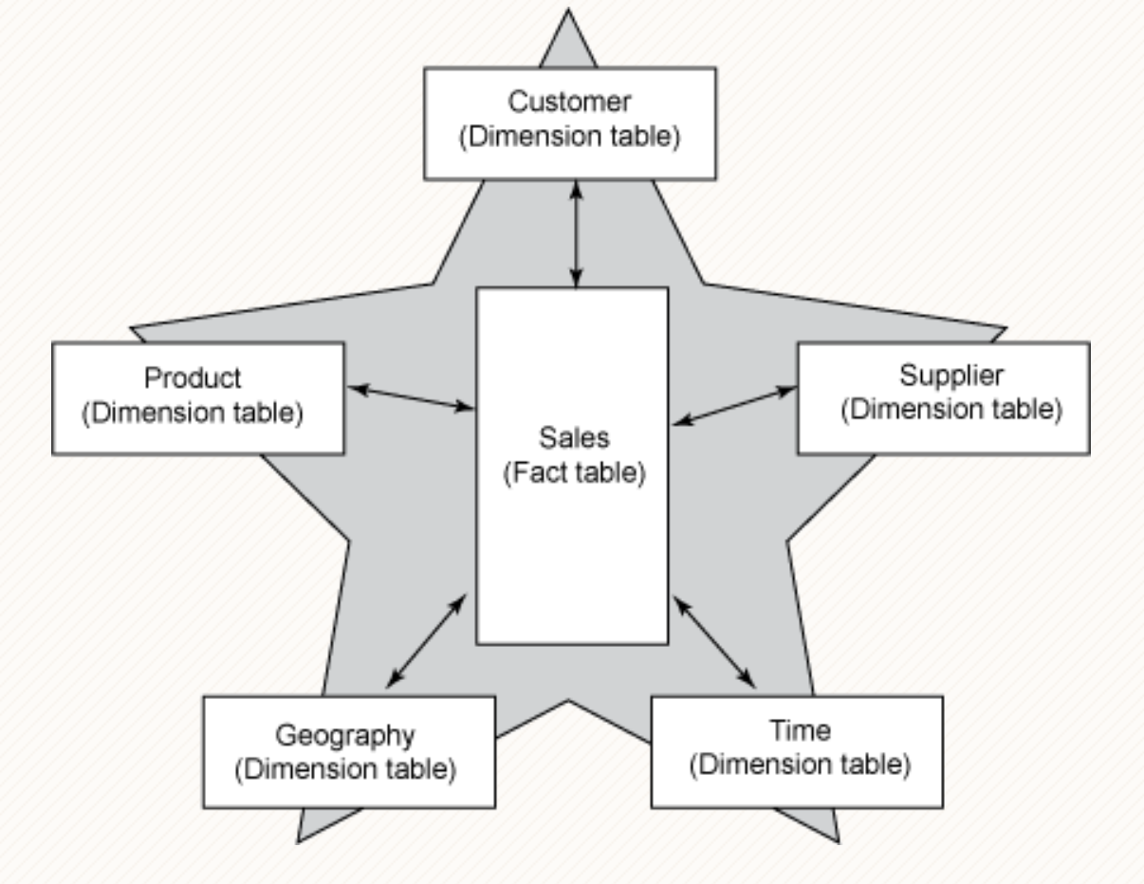
Facts and Dimensions

Slide 58
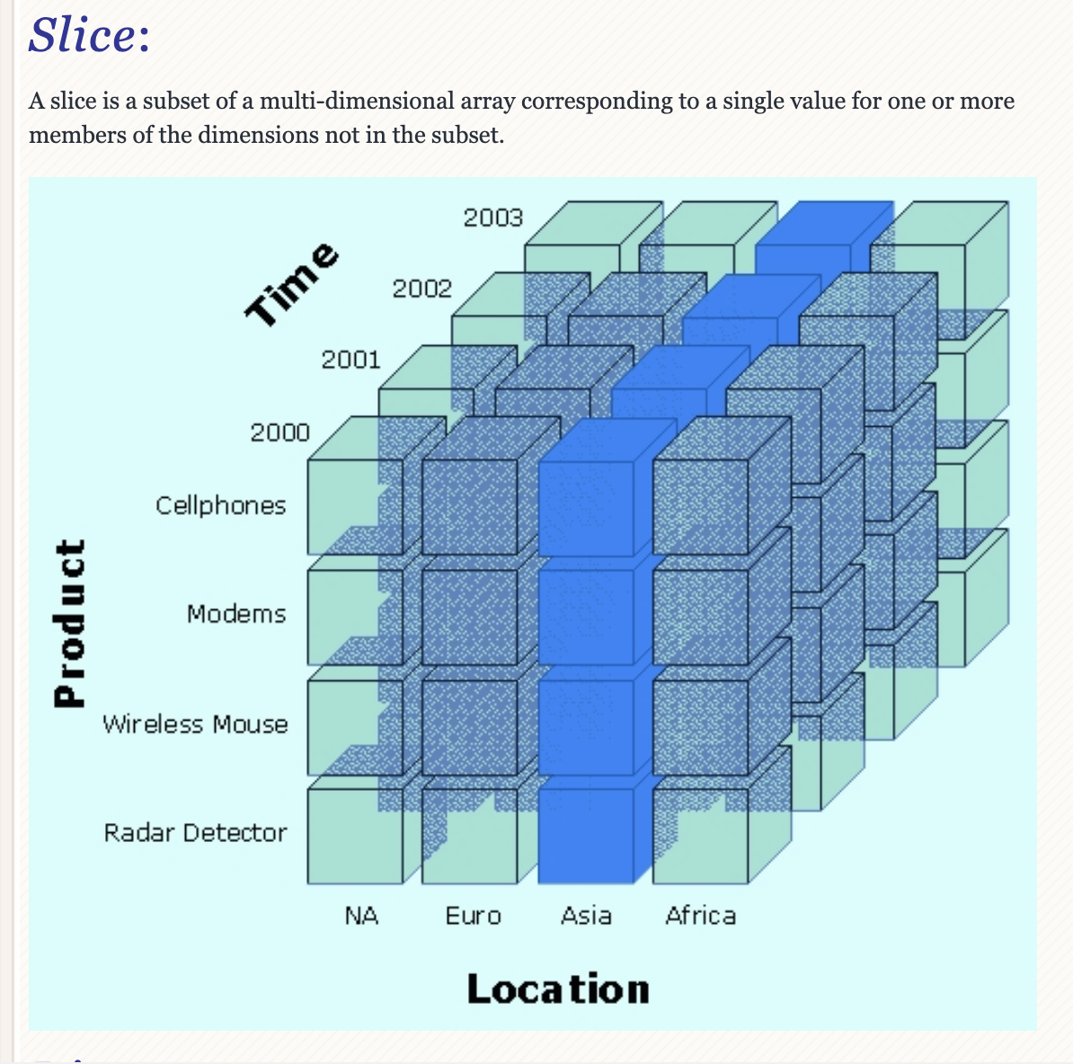
Slice

Slide 59
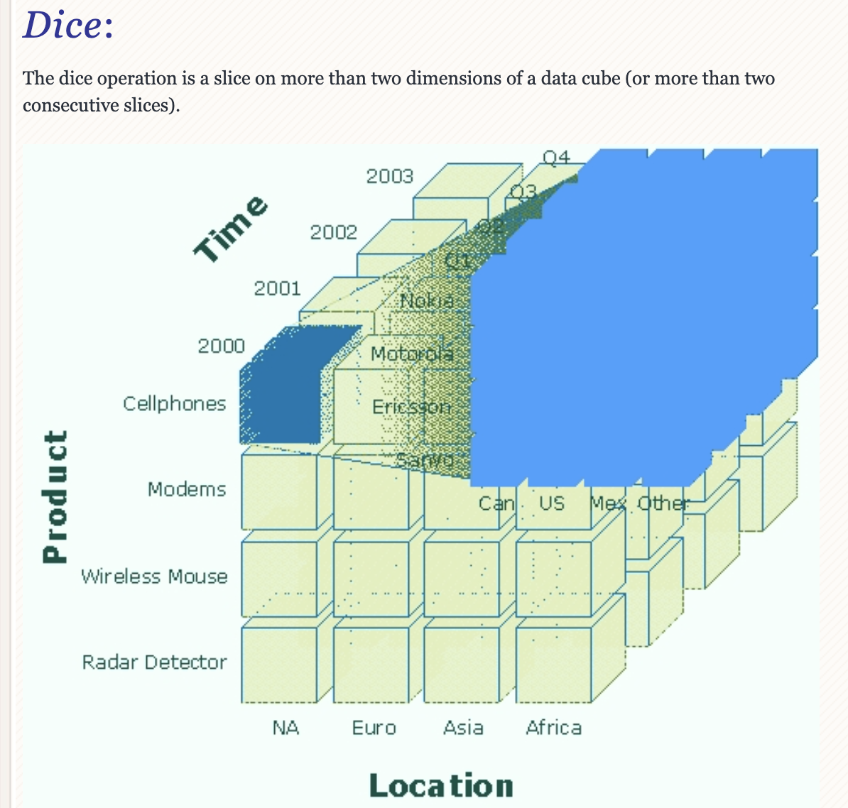
Dice

Slide 60
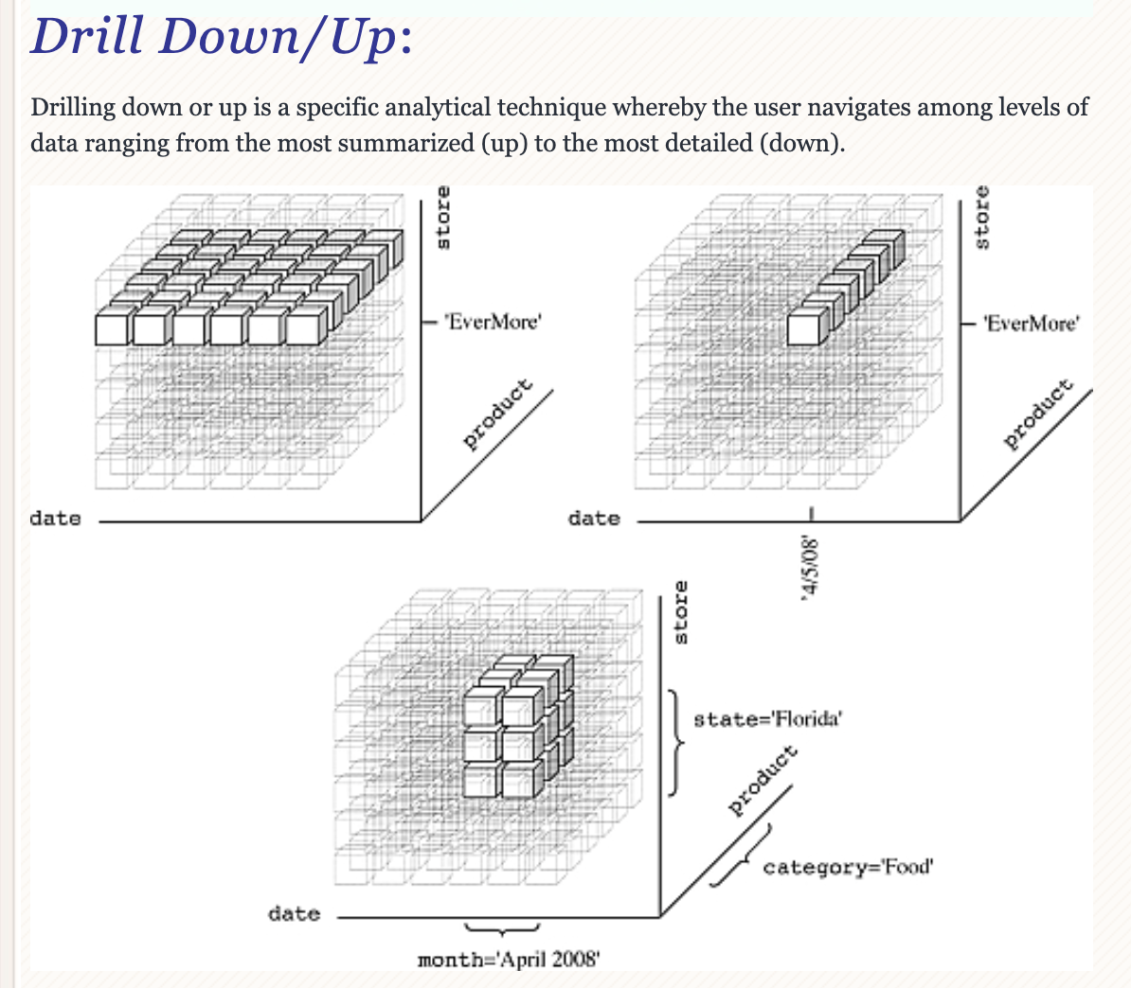
Drilling

Slide 61
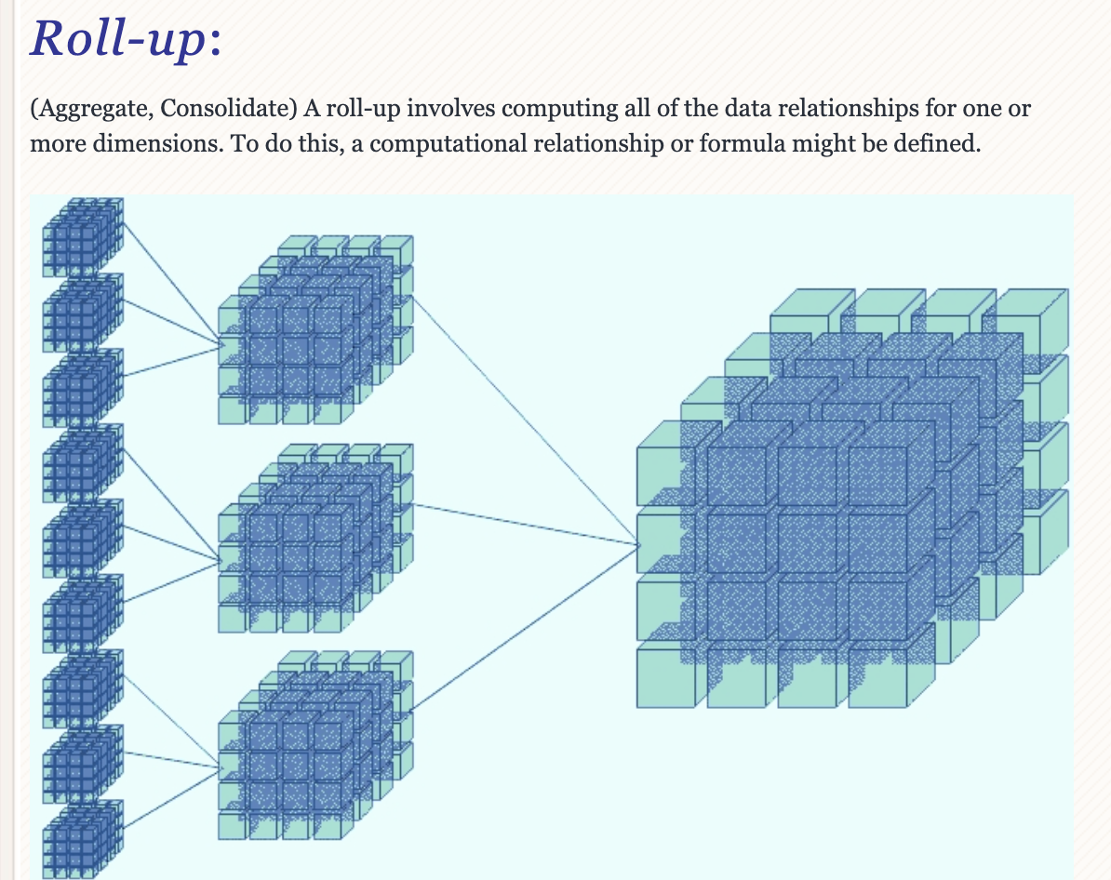
Roll-up

Slide 62
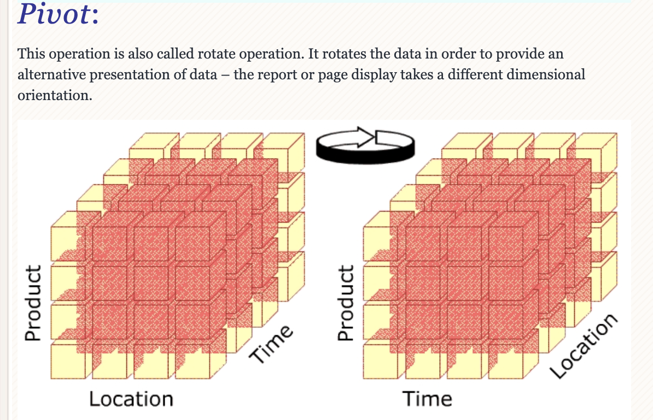
Pivot

Slide 63
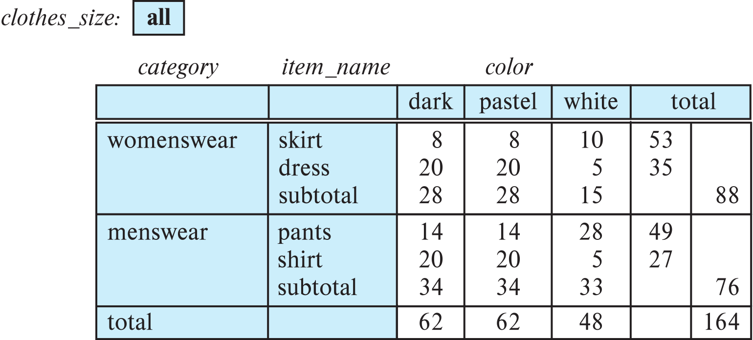
Cross Tabulation With Hierarchy
Cross-tabs can be easily extended to deal with hierarchies
Can drill down or roll up on a hierarchy
E.g. hierarchy: item_name → category

Slide 64
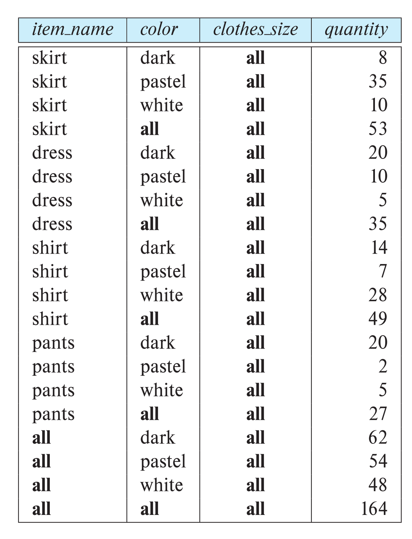
Relational Representation of Cross-tabs
Cross-tabs can be represented as relations
We use the value all to represent aggregates.
The SQL standard actually uses null values in place of all
Works with any data type
But can cause confusion with regular null values.

Slide 65
Walk Through Some Code
Wide Flat Tables
Complex Mongo Query
… …

Slide 66
Summary
Next Steps

